Slide 1

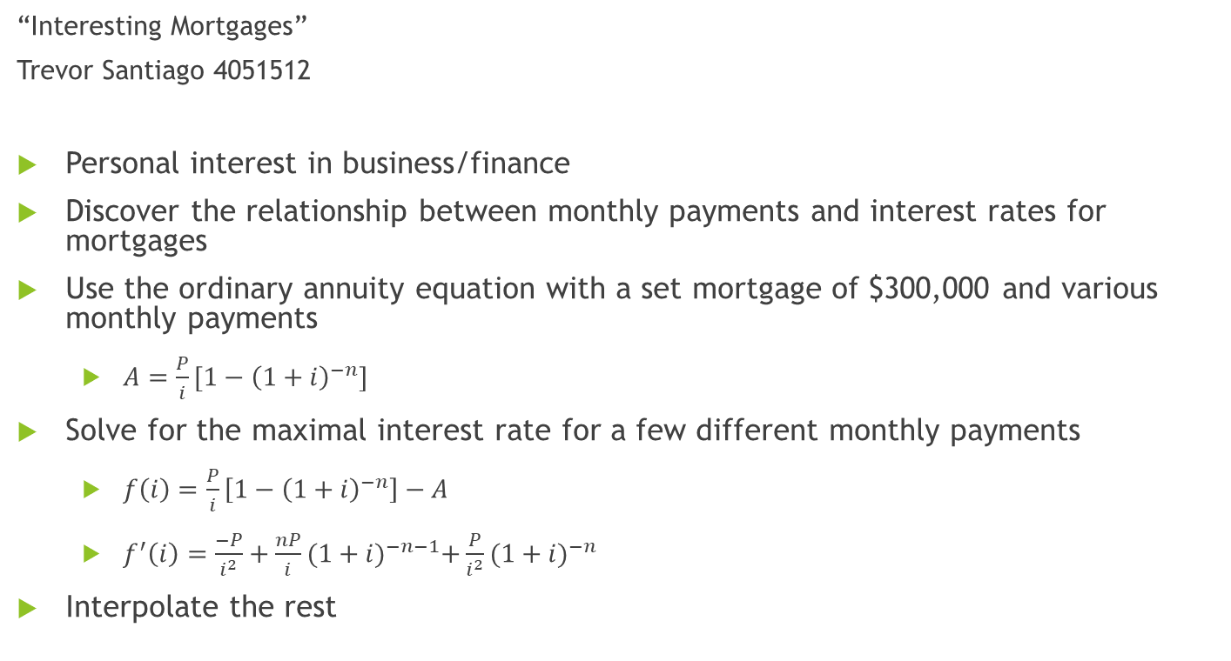
Problem and Motivation
“Interesting Mortgages”
Trevor Santiago 4051512
Personal interest in business/finance
Discover the relationship between monthly payments and interest rates for mortgages
Use the ordinary annuity equation with a set mortgage of $300,000 and various monthly payments
$A=\frac{P}{i}[1−{\left(1+i\right)}^{−n}]$
Solve for the maximal interest rate for a few different monthly payments
$f\left(i\right)=\frac{P}{i}\left[1−{\left(1+i\right)}^{−n}\right]−A$
$f^{′}\left(i\right)=\frac{−P}{i^{2}}+\frac{nP}{i}{(1+i)}^{−n−1}+\frac{P}{i^{2}}{(1+i)}^{−n}$
Interpolate the rest

Slide 2
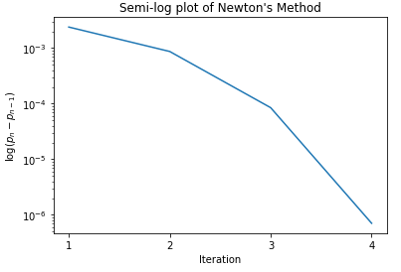
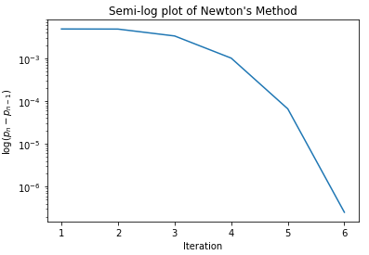
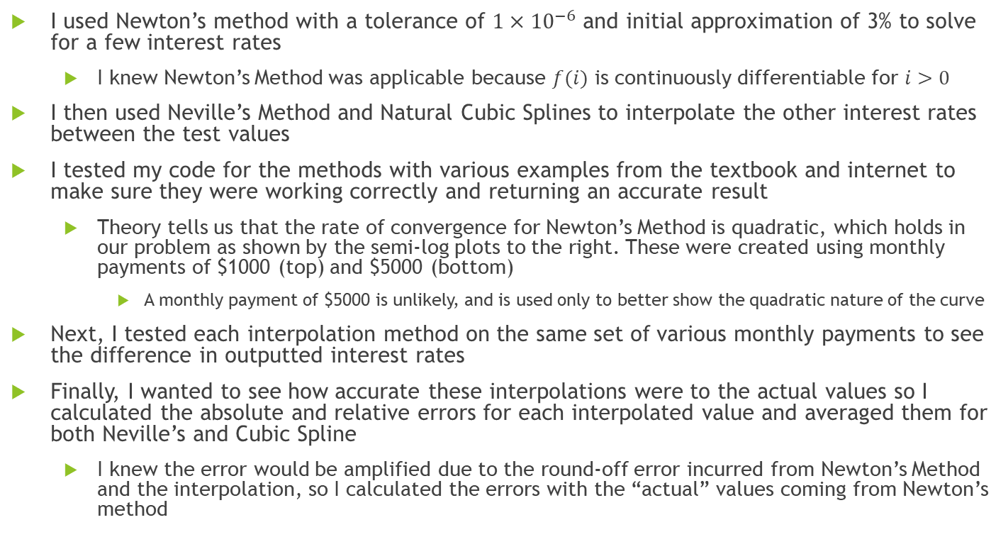
Methods
I used Newton’s method with a tolerance of $1×{10}^{−6}$ and initial approximation of 3% to solve for a few interest rates
I knew Newton’s Method was applicable because $f(i)$ is continuously differentiable for $i>0$
I then used Neville’s Method and Natural Cubic Splines to interpolate the other interest rates between the test values
I tested my code for the methods with various examples from the textbook and internet to make sure they were working correctly and returning an accurate result
Theory tells us that the rate of convergence for Newton’s Method is quadratic, which holds in our problem as shown by the semi-log plots to the right. These were created using monthly payments of $1000 (top) and $5000 (bottom)
A monthly payment of $5000 is unlikely, and is used only to better show the quadratic nature of the curve
Next, I tested each interpolation method on the same set of various monthly payments to see the difference in outputted interest rates
Finally, I wanted to see how accurate these interpolations were to the actual values so I calculated the absolute and relative errors for each interpolated value and averaged them for both Neville’s and Cubic Spline
I knew the error would be amplified due to the round-off error incurred from Newton’s Method and the interpolation, so I calculated the errors with the “actual” values coming from Newton’s method

Slide 3

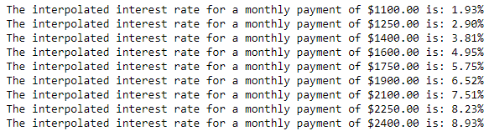
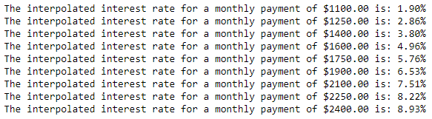
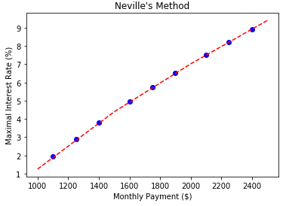
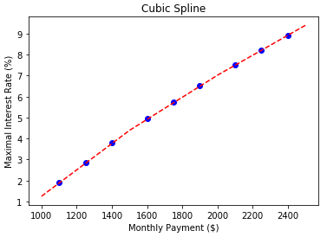

Results
Initial testing values:
Neville’s Method
Natural Cubic Spline
Interpolated values
Error
Interpolated values
Error

